Slide 1
DBMS

Slide 2
Topics
Unit 4:
- An overview of NoSQL
- Characteristics of NoSQL
- NoSQL storage types
- Advantages and Drawbacks of NoSQL
- Case Study: Application definition Requirement Analysis
- Implementation using MongoDB
- Database Queries
- Writing Queries

Slide 3
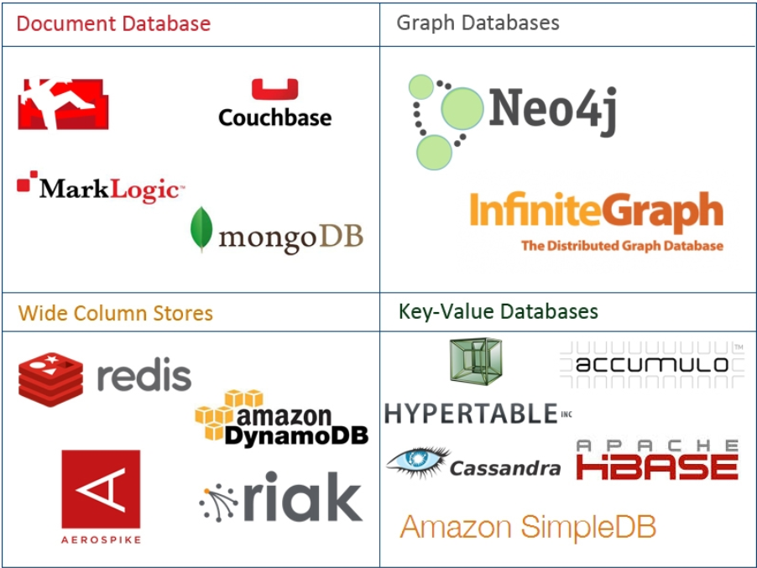
NOSQL!
NoSQL databases are currently a hot topic in some parts of computing, with over a hundred different NoSQL databases.

Slide 4
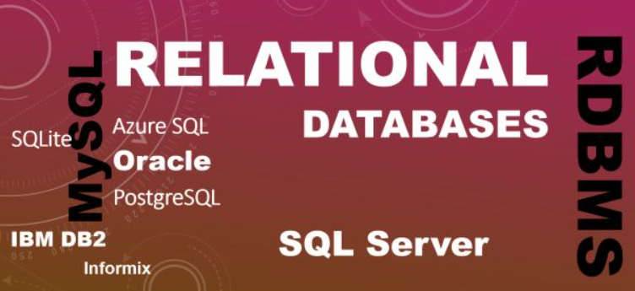
RDBMS CHARACTERISTICS
Data stored in columns and tables
Relationships represented by data
Data Manipulation Language
Data Definition Language
Transactions
Abstraction from physical layer
Applications specify what, not how
Physical layer can change without modifying applications
Create indexes to support queries
In Memory databases

Slide 5
NO SQL?
NoSQL stands for:
No Relational
No RDBMS
Not Only SQL
NoSQL is an umbrella term for all databases and data stores that don’t follow the RDBMS principles
A class of products
A collection of several (related) concepts about data storage and manipulation
Often related to large data sets

Slide 6
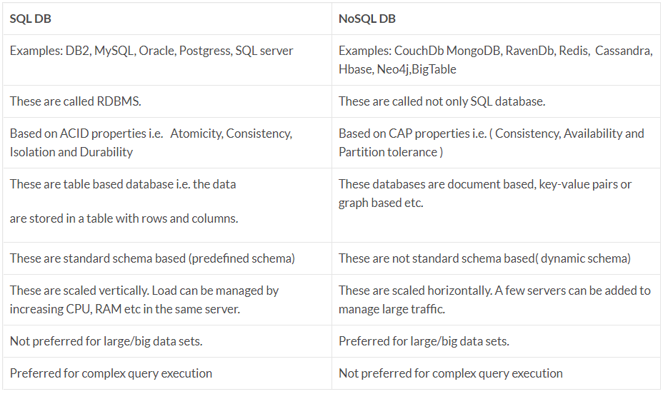
NOSQL VS. SQL

Slide 7
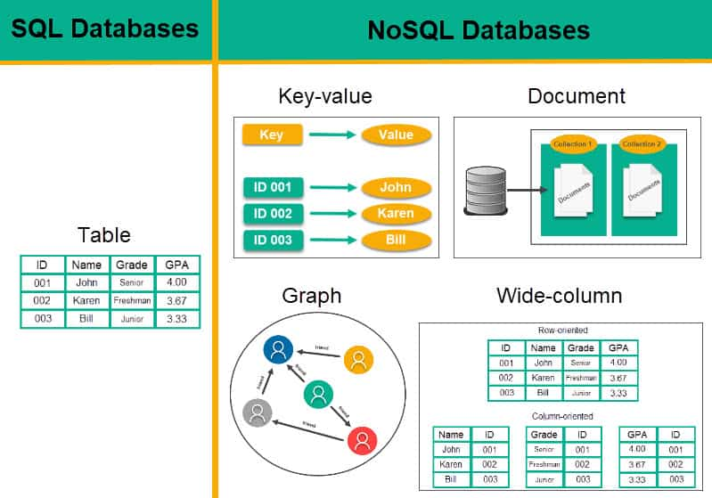

Slide 8
WHERE DOES NOSQL COME FROM?
Non-relational DBMSs are not new
But NoSQL represents a new incarnation
Due to massively scalable Internet applications
Based on distributed and parallel computing
Development
Starts with Google
First research paper published in 2003
Continues also thanks to Lucene's developers/Apache (Hadoop) and Amazon (Dynamo)
Then a lot of products and interests came from Facebook, Netfix, Yahoo, eBay, Hulu, IBM, and many more

Slide 9
Defining NoSQL
In computing, NoSQL (mostly interpreted as "not only SQL") is a broad class of database management systems identified by its non-adherence to the widely used relational database management system model;
that is, NoSQL databases are not primarily built on tables, and as a result, generally do not use SQL for data manipulation

Slide 10
What NoSQL is and What NoSQL is not
NoSQL is a generic term used to refer to any data store that does not follow the traditional RDBMS model
Specifically, the data is non-relational and it does not use SQL as the query language.
It is used to refer to the databases that attempt to solve the problems of scalability and availability against that of atomicity or consistency.

Slide 11
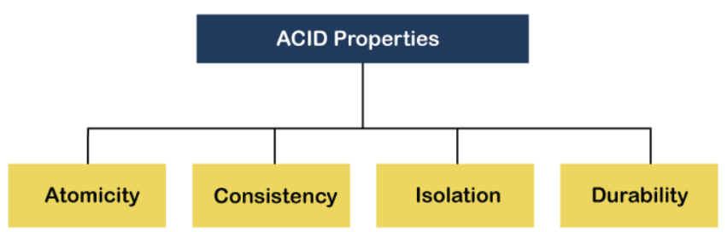
TRANSACTIONS – ACID PROPERTIES
Atomic – All of the work in a transaction completes (commit) or none of it completes
Consistent – A transaction transforms the database from one consistent state to another consistent state. Consistency is defined in terms of constraints.
Isolated – The results of any changes made during a transaction are not visible until the transaction has committed.
Durable – The results of a committed transaction survive failures
Notes:
a transaction to transfer funds from one account to another involves making a withdrawal operation from the first account and a deposit operation on the second. If the deposit operation failed, you don’t want the withdrawal operation to happen either.
a database tracking a checking account may only allow unique check numbers to exist for each transaction
a teller looking up a balance must be isolated from a concurrent transaction involving a withdrawal from the same account. Only when the withdrawal transaction commits successfully and the teller looks at the balance again will the new balance be reported.
A system crash or any other failure must not be allowed to lose the results of a transaction or the contents of the database. Durability is often achieved through separate transaction logs that can "re-create" all transactions from some picked point in time (like a backup).

Slide 12




Difficulties with ACID property
quite incompatible with availability and performance on applications of web-scale.
For example:

Slide 13
Difficulties with ACID property
Amazon will work very slow in the following scenario.
For example:
If I proceed to buy a book and a transaction is on, it will lock a part of the database, specifically the inventory, and every other person in the world will have to wait until I complete my transaction.

Slide 14
Solution: BASE
Look beyond ACID to something called BASE , coined by Eric Brewer
Basic availability: Each request is guaranteed a response—successful or failed execution.
Soft state: The state of the system may change over time, at times without any input (for eventual consistency).
Eventual consistency: The database may be momentarily inconsistent but will be consistent eventually

Slide 15
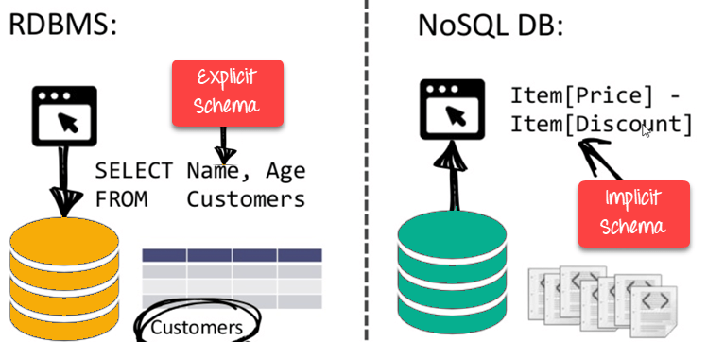
Why NoSQL(1)?
Schemaless data representation:
Almost all NoSQL implementations offer schemaless data representation.
This means that you don’t have to think too far ahead to define a structure and you can continue to evolve over time—including adding new fields or even nesting the data, for example, in case of JSON representation.

Slide 16
Why NoSQL? (2)
Development time: Reduced development time because one doesn’t have to deal with complex SQL queries.
Speed: Even with the small amount of data that you have, if you can deliver in milliseconds rather than hundreds of milliseconds —especially over mobile and other intermittently connected devices—you have much higher probability of winning users over.
Plan ahead for scalability: your application can be quite elastic—it can handle sudden spikes of load. Of course, you win users over straightaway

Slide 17
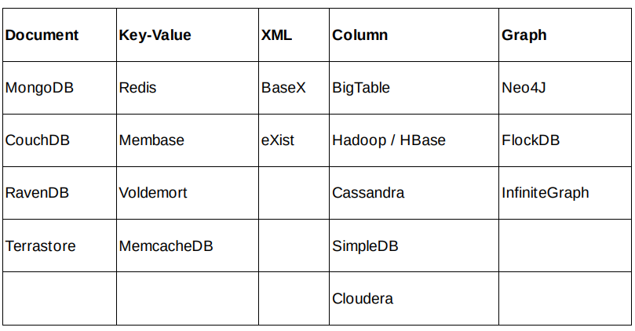
List of NoSQL Databases
Details regarding the types f databases will be illustrated later….

Slide 18
Characteristics of NoSQL

Slide 19
Let’s have a look back at the designing phase of RDBMS approach (steps):
Identify actors
Define models
Define entities
Define relationships
Program database and application
Iterate

Slide 20
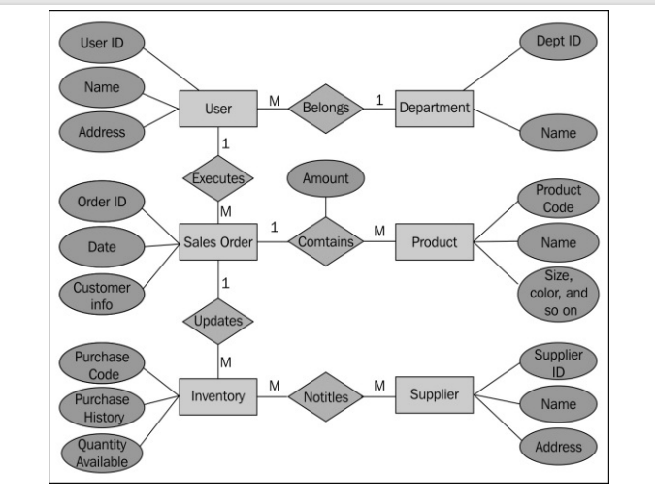
Example

Slide 21
Example(Cont.)
Few of the actors identified include buyer, employee, purchaser, administrator, office address, shipping address, supplier address, item in inventory, and supplier.
They may be mapped to a model UserProfile and there may be subclasses as required—Administrator and PointOfSalesUser. Some of the other models include Department, Role, Product, Supplier, Address, PurchaseOrder, and Invoice.
Simplistically, a database table may map each actor to a model.
Foreign keys will be used to define the object relationships—one-to-many between Department and UserProfile, many-to-many between Role and UserProfile, and PurchaseOrder and Product.

Slide 22
Challenges with RBMS approach
Difficult to maintain database—schema, programmability, business continuity process a.k.a. availability, and other aspects
How to expand their web presence and enable online orders??
The company acquires another company and now needs to integrate the two database systems.
The company grows big and has to handle hundreds of millions of queries a day across the country
The company plans to provide API integration for aggregators to retrieve and process their data

Slide 23
Demands to satisfy Functional Requirements!!!
Schema flexibility:This will be needed during future enhancements and integration with external applications
Complex queries : so-called JOIN queries which are not only difficult to implement and maintain but also take substantial database resources to execute
Data update: Updating data across tables is probably one of the more complex scenarios especially if they are to be a part of the transaction.
Scalability

Slide 24
NoSQL approach
Following are the approaches followed by NoSQL to find the solutions to the challenges faced by database systems
Schema flexibility
No Complex queries
Data update
Scalability

Slide 25
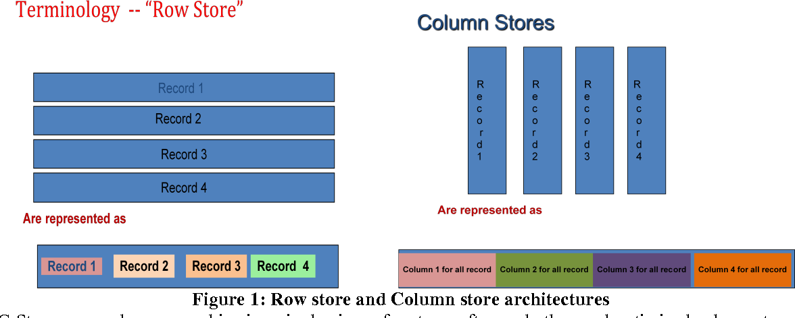
NoSQL approach(1)
Schema flexibility:Columnoriented DBMS store data as columns as opposed to rows in RDBMS. This allows flexibility of adding one or more columns as required, on the fly. Similarly, document stores that allow storing semi-structured data are also good options.

Slide 26
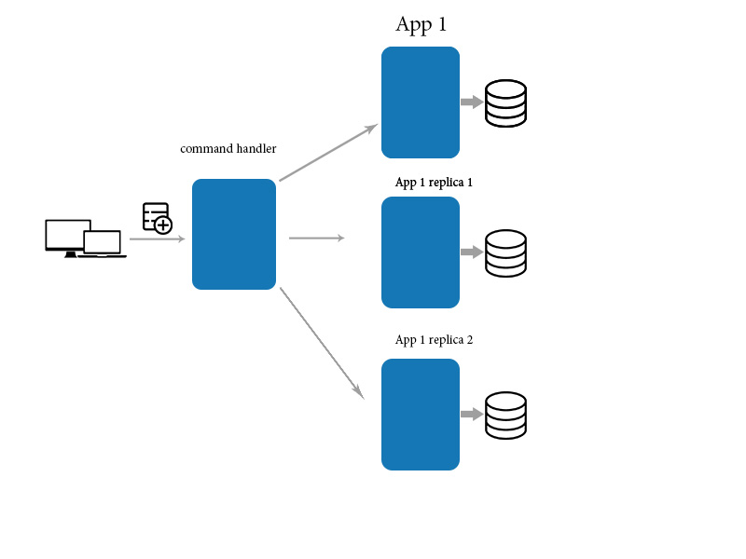
NoSQL approach(2)
2. No Complex queries: NoSQL databases do not have support for relationships or foreign keys. There are no complex queries. There are no JOIN statements.
3. Data update: Data update and synchronization across nodes within a datacenter has a different set of requirements as compared to synchronizing across multiple datacenters.
Need minimum latency
NoSQL solutions offer great synchronization options.

Slide 27
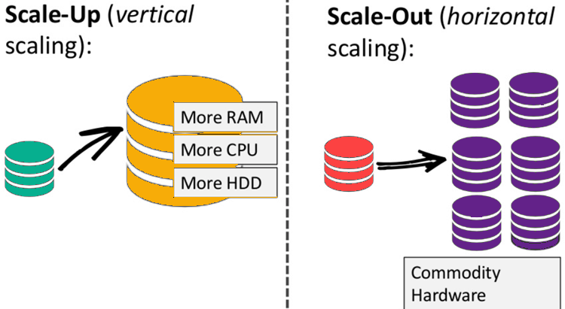

NoSQL approach(3)
4. Scalability:. A lot of complexity that is required for transaction oriented RDBMS does not exist in ACID non-compliant NoSQL databases.

Slide 28
NOSQL Storage TYPES

Slide 29
NOSQL Storage TYPES
The NoSQL databases are categorized on the basis of how the data is stored.
Because of the need to provide curated information from large volumes, generally in near real-time, NoSQL mostly follows a horizontal structure.
They are optimized for insert and retrieve operations on a large scale with built-in capabilities for replication and clustering.

Slide 30
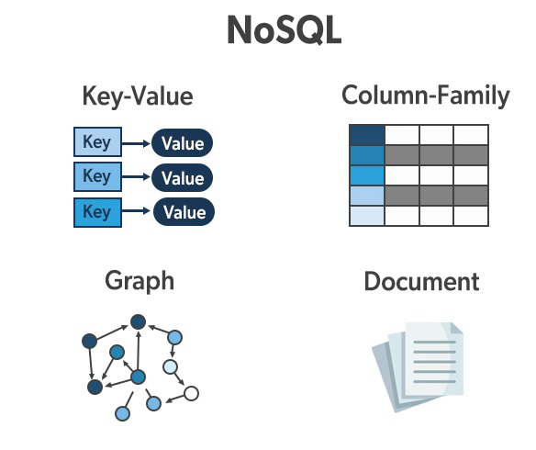
NOSQL Storage TYPES

Slide 31
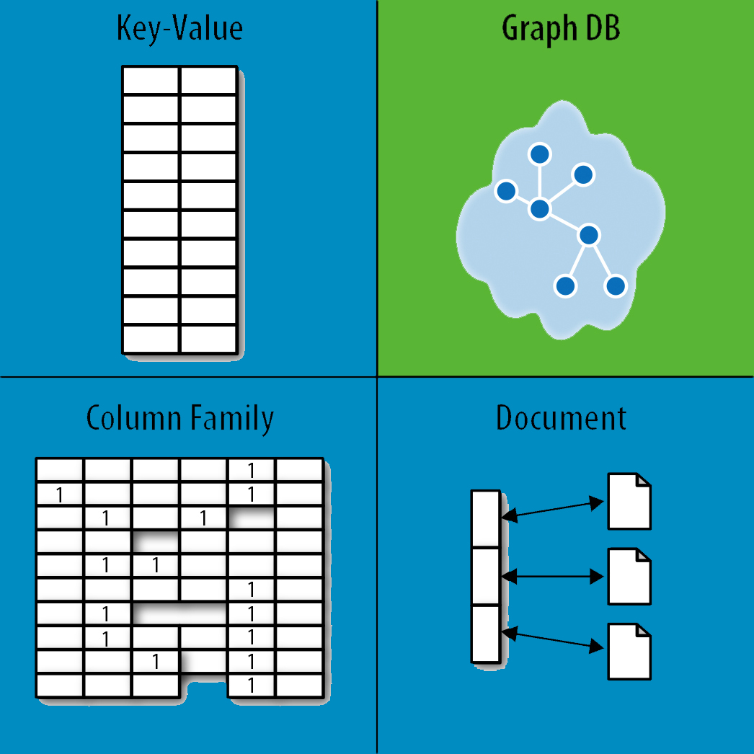
NOSQL Storage TYPES
Discussing NoSQL databases is complicated because there are a variety of types:
Column-oriented databases
Optimized for queries over large datasets, and store columns of data together, instead of rows
Document databases:
pair each key with a complex data structure known as a document.
Key-Value Store :
are the simplest NoSQL databases. Every single item in the database is stored
as an attribute name (or 'key'), together with its value.
Graph Databases :
are used to store information about networks of data, such as social connections.

Slide 32
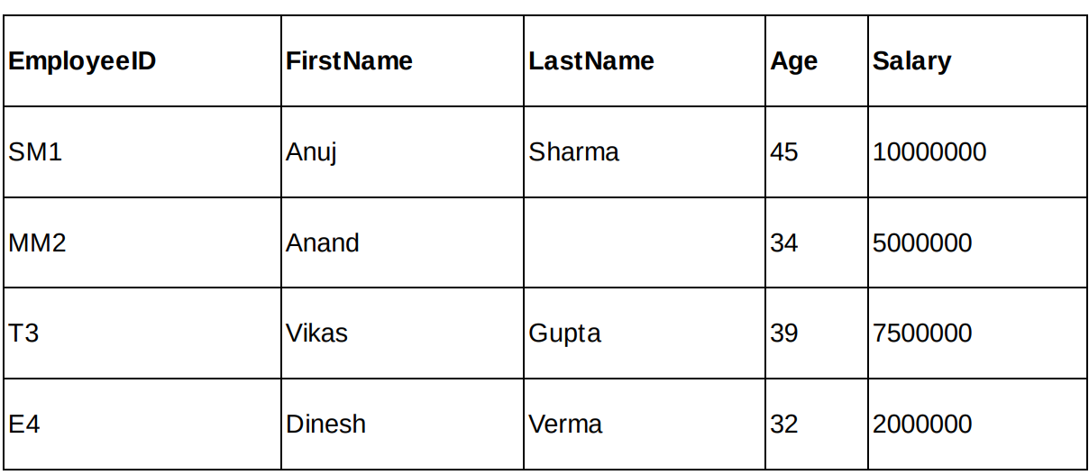
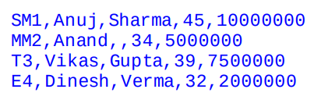
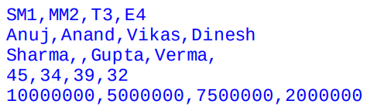
Column-oriented databases
Row Oriented Storage
Column Oriented Storage

Slide 33
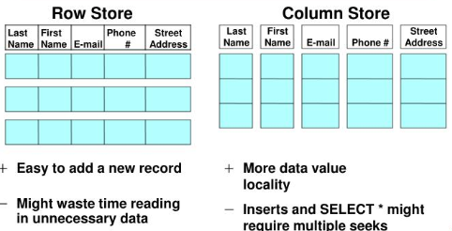
COLUMN-ORIENTED STORES
Data are stored in a column-oriented way
Data efficiently stored
Avoids consuming space for storing nulls
Columns are grouped in column-families
Data isn’t stored as a single table but is stored by column families
Unit of data is a set of key/value pairs
Identified by “row-key”
Ordered and sorted based on row-key
Notable for:
Google's Bigtable (used in all Google's services)
HBase (Facebook, StumbleUpon, Hulu, Yahoo!, ...)

Slide 34
Advantages of Column Oriented Database
Allow adding columns over time without having to worry about filling in default values for the existing rows for the new columns.
This gives flexibility in model and entity design allowing one to account for new columns in future for unforeseen scenarios and new requirements.
Similarly, when new values are applied for either all rows at once or with same-column filters, these databases will allow partial data access without touching unrelated columns and be much faster in execution.
Since columns will be of uniform type and mostly (except in cases of variable-length strings) of the same length, there are possibilities of efficient storage in terms of size.

Slide 35
DOCUMENT DATABASES, JSON
{
_id: ObjectId("51156a1e056d6f966f268f81"),
type: "Article",
author: "Derick Rethans",
title: "Introduction to Document Databases with MongoDB",
date: ISODate("2013-04-24T16:26:31.911Z"),
body: "This arti…"
},
{
_id: ObjectId("51156a1e056d6f966f268f82"),
type: "Book",
author: "Derick Rethans",
title: "php|architect's Guide to Date and Time Programming with PHP",
isbn: "978-0-9738621-5-7"
}
Different Details

Slide 36
DOCUMENT DATABASES
Documents
Loosely structured sets of key/value pairs in documents, e.g., XML, JSON
Encapsulate and encode data in some standard formats or encodings
Are addressed in the database via a unique key
Documents are treated as a whole, avoiding splitting a document into its constituent name/value pairs
Allow documents retrieving by keys or contents
Notable for:
MongoDB (used in FourSquare, Github, and more)
CouchDB (used in Apple, BBC, Canonical, Cern, and more)

Slide 37
DOCUMENT DATABASES
The central concept is the notion of a "document“ which corresponds to a row in RDBMS.
A document comes in some standard formats like JSON (BSON).
Documents are addressed in the database via a unique key that represents that document.
The database offers an API or query language that retrieves documents based on their contents.
Documents are schema free, i.e., different documents can have structures and schema that differ from one another. (An RDBMS requires that each row contain the same columns.)

Slide 38
DOCUMENT DATABASES - Advantages
content is schemaless, or at best loosely defined. This is very useful in web-based applications where there is a need for storing different types of content that may evolve over time.
For example, for a grocery store, information about the users, inventory and orders can be stored as simple JSON or XML documents.
it may or may not be possible to retrieve or update a record partially. If it is possible to do so, there is a great advantage.
Searching across multiple entity types is far more trivial compared to doing so in traditional RDBMS or even in column-oriented databases. Because, now, there is no concept of tables —which is essentially nothing more than a schema definition—one can query across the records, irrespective of the underlying content or schema or in other words, the query is directly against the entire database
JSON-based stores are easy to define what can be called as projections . Each top-level key for the JSON object may be the entity's projection across other parts of the system thereby allowing the schema to evolve over time with backward compatibility.

Slide 39
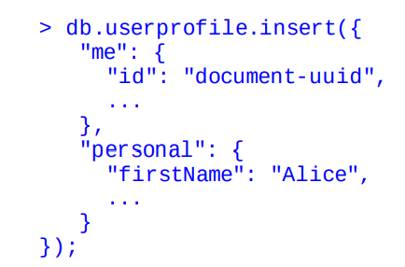
Example: MongoDB
create a collection
Inserting a record into userprofile collection

Slide 40
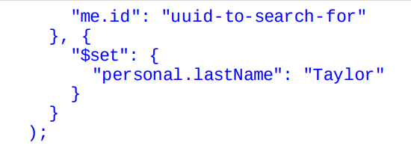
Example: MongoDB
-Update
To update a record, use the update method that expects two arguments.
The first argument is a query to filter the record to be updated.
The second argument provides details about the updated values.
Where clause of SQL
Set of Update Query

Slide 41
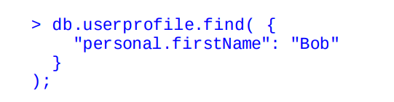
find() method
To retrieve records, we can use any of the attributes:

Slide 42
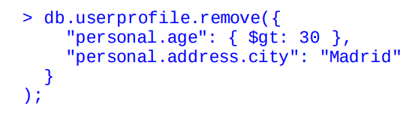
remove() method
To delete a record or records, all that is required is to be able to query for appropriate attribute or attributes.
For example, to remove profiles whose age is greater than 30 and the city of thier personal address is Madrid:

Slide 43
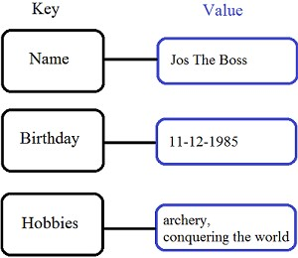
KEY/VALUE STORES
Store data in a schema-less way
-storage of a value against a key.
Similar to a document store,
there is no need for a schema to be enforced on the value
Notable for:
Redis (in-memory, with dump or command-log persistence)
Memcached (in-memory)
MemcacheDB (built on Memcached)
Berkley DB Voldemort (open source implementation of Amazon Dynamo)

Slide 44
KEY/VALUE STORES(2)
Difference with Document DB
Unlike a document store that can create a key when a new document is inserted, a key-value store requires the key to be specified
Unlike a document store where the value can be indexed and queried, for a key-value store, the value is opaque and as such, the key must be known to retrieve the value

Slide 45
KEY/VALUE STORES-Advantage
-Key-value stores are optimized for querying against keys.
- As such, they serve great in memory caches
Memcached and Redis support expiry for the keys—sliding or absolute— after which the entry is evicted from the store.

Slide 46
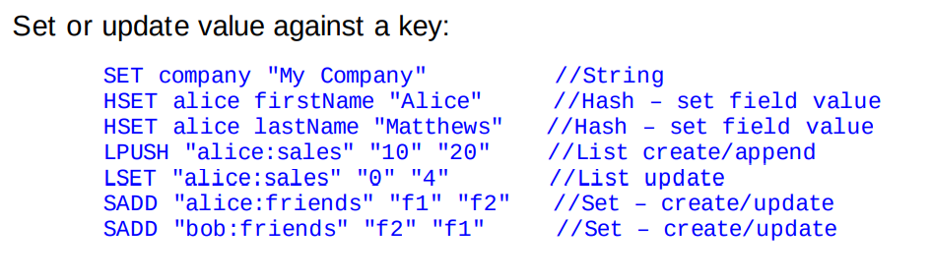
Examples(1)

Slide 47
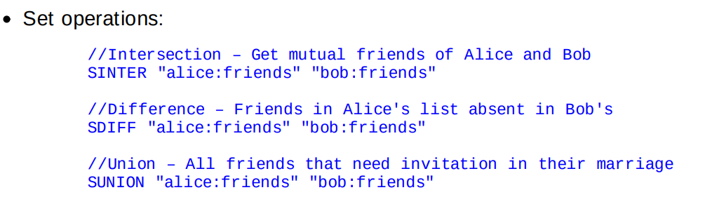
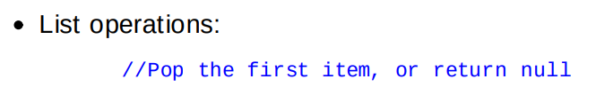
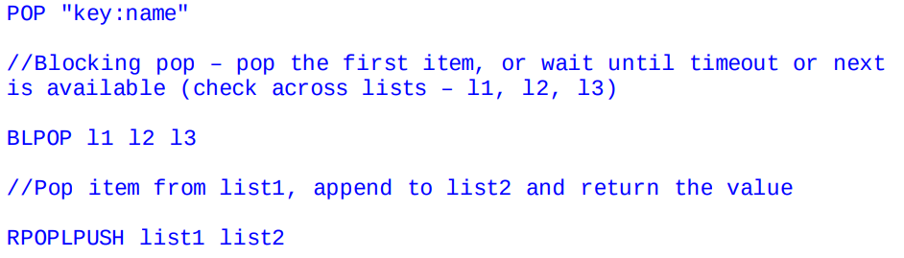
Examples(2)

Slide 48
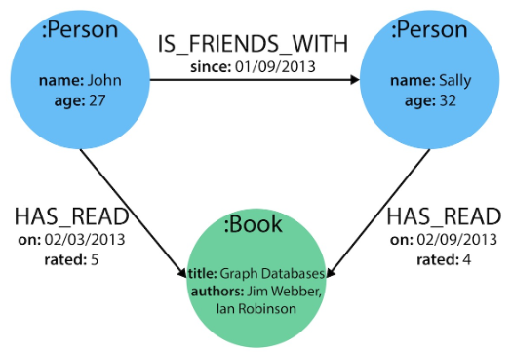
GRAPH DATABASES
Graph-oriented
Everything is stored as an edge, a node or an attribute.
Each node and edge can have any number of attributes.
Both the nodes and edges can be labelled.
Labels can be used to narrow searches.
Notes:
A graph database is a purpose-built database to store and navigate relationships in computing. It stores nodes and relationships instead of tables or documents in a graph structure for semantic queries. The nodes store data entities (users, companies, or any data an organization determines to record). The edges are used to keep the relationship between the entities so that the users can understand it easily. Data is accumulated without limiting it to a pre-defined model, authorizing a very adjustable way of analyzing it and using it.
A node in a graph database can have any number and kind of relationship. In contrast, an edge always has a start node, end node, type, and direction. An edge node can also represent a parent-child relationship, actions, and ownership. Most organizations use graph-based databases to pull precise and in-depth data and solve complex queries regarding their customer and user inputs.

Slide 49
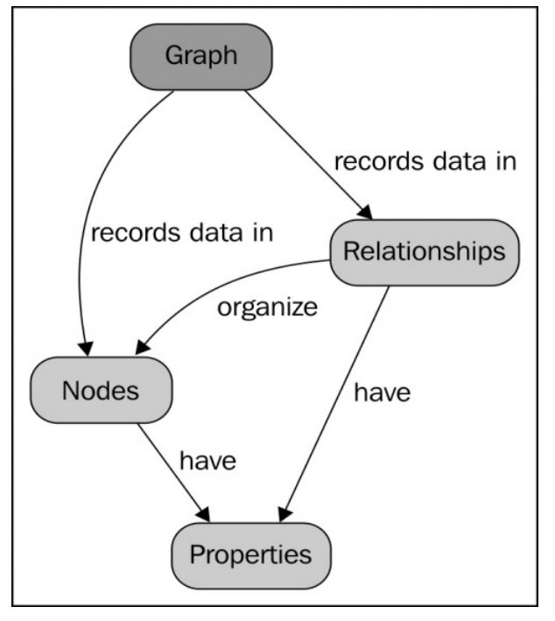
GRAPH DATABASES
Relationships are represented as graphs.
There can be multiple links between two nodes in a graph— representing the multiple relationships that the two nodes share
Example: social relationships between people, transport links between places
Notes:
A graph database is a purpose-built database to store and navigate relationships in computing. It stores nodes and relationships instead of tables or documents in a graph structure for semantic queries. The nodes store data entities (users, companies, or any data an organization determines to record). The edges are used to keep the relationship between the entities so that the users can understand it easily. Data is accumulated without limiting it to a pre-defined model, authorizing a very adjustable way of analyzing it and using it.
A node in a graph database can have any number and kind of relationship. In contrast, an edge always has a start node, end node, type, and direction. An edge node can also represent a parent-child relationship, actions, and ownership. Most organizations use graph-based databases to pull precise and in-depth data and solve complex queries regarding their customer and user inputs.

Slide 50
Advantages
Graph databases can be considered as special purpose NoSQL databases optimized for relation-heavy data.
Easy representation, retrieval and manipulation of relationships between the entities in the system.
It is not uncommon to store data in a document store and relationships in a graph database.

Slide 51
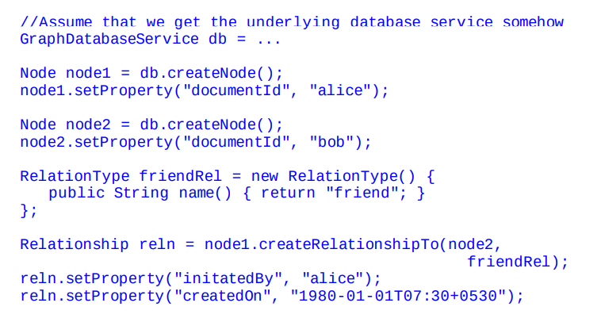
EXAMPLES

Slide 52
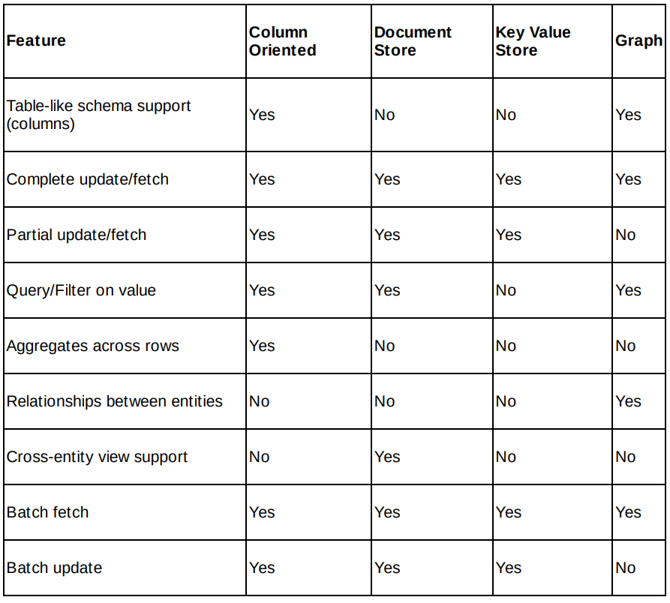
Comparing the models

Slide 53
Advantages and Drawbacks

Slide 54
Advantages and Drawbacks
We will take three different representative application requirements and discuss advantages and disadvantages of using NoSQL
Transactional application
Computational application
Web-scale application

Slide 55
1.Transactional application
This type of application has data that is highly relational in nature.
An example of this is the application at the point-of-sales at a grocery shop or an enterprise resource management application. The key here is data consistency.
Entity schema requirements
For a transactional application, general requirements for the entity schema include:
Highly structured definition—properties, types, and constraints, if applicable
Ability to define relationships—parent versus child keys
Schema does not evolve or vary too much over time.
Data access requirements
From a data access perspective, we would have the following requirements:
Consistency—any read should return latest updated data
More often than not, the entire record (row) will be retrieved
Cross-entity (table) data access may be frequent

Slide 56
1.Transactional application (Contd…)
What NoSQL can do
For a transactional application, NoSQL can help as follows:
Column-oriented database helps define structure. If need be, it can be changed over time.
Document-oriented database can help implement JOIN or create views.
What NoSQL cannot do
Using NoSQL will result in a few limitations for a transactional application: Inability to define relationships Absence of transactions
Unavailability of ACID properties in operations
Using Cassandra or CouchDB can be overkill if we compare them to, for example, MySQL or PostgreSQL—they do not unleash their true power in a single-machine installation
Absence of support for JOIN and cross-entity query, though document-oriented stores support it by way of MapReduce but the efforts may be substantial as the queries get complex
Decision
Choose RDBMS rather than NoSQL. The disadvantages outweigh the advantages

Slide 57
2. Computational application
This type of application does a lot of computation in the application
An example of this type of application is a survey application or a sales record management application. The key here is that the computation is across the records but on a subset of the properties or columns available
Entity schema requirements
For a computational application, general requirements on the entity schema include:
Structured schema definition—properties, types, and constraints, if applicable.
Schema does not evolve or vary too much over time.
Data access requirements: From a data access perspective, we would have the following requirements:
Partial record access.
Vertical, that is, column-wise processing.
For example, for an entity holding the data of daily revenues and expenses at a given location of operation, one would compute across the revenue column and/or expense column more often than working on the entire row.
Cross-entity data access is infrequent.
For example, to create the final balance sheet for a location, I may use the location ID once to get the details about the location.
Consistency—data should be consistent. However, in some cases, minor latencies are allowed.
For example, since the reports may be generated daily rather than in real-time, the user is happy working with day-old data

Slide 58
2. Computational application (Contd…)
What NoSQL can do : For a computational application, NoSQL can help as follows:
Column-oriented databases would help define rigorous schema.
Document or keyvalue databases can still be used.
For example, JSON formats can be used to define a formal schema. Just that these
stores cannot enforce the schema.
They (column-oriented, key-value as well as document stores) can provide speed and
scale while fetching partial data.
Document stores coupled with MapReduce processing can help performing
computation right up close to the data-tier thereby substantially increasing the speed
of execution. You do not want unnecessary data to be floating across the network.
Document stores can help implement JOIN or create views.
What NoSQL cannot do
Using NoSQL will result in a few limitations for a computational application:
Defining relationships can be tricky. Except for graph databases, these relationships must be maintained in application.
Because relationships do not exist in the database, data can be inconsistent—even if momentarily.

Slide 59
2. Computational application (Contd…)
Decision
To conclude, it is a tough choice between RDBMS and NoSQL databases in this case. If the application is, say, an enterprise application wherein the number of records will be limited to around, for example, a hundred million or lower, RDBMS can just serve it right, though NoSQL can also be used. For any size less than a million records, NoSQL can have overheads in terms of setup and tuning; while for over a few hundred million records, RDBMS will taper down in performance.

Slide 60
3. Web-Scale application
This last application type is probably more relevant today in consumer applications, whether they are completely web-based or mobile-native apps or a combination of both.
An example of this application is a web analytics application or a social microblogging platform. The key here is the scale of operation and staleness of data.
Entity schema requirements
For a web-scale application, general requirements on the entity schema include:
Structured schema definition
The ability to change schema over time without affecting existing records in any manner—in extreme case, latent schema
Relationships may be optional at database layer and can be pushed to application layer mainly because of the low density
Data access requirements: From a data access perspective, we would have the following requirements:
Partial record access
Speed of operation execution—CRUD
Inconsistent data—for a short moment—is tolerable

Slide 61
3. Web-Scale application (Contd…)
What NoSQL can do
For a web-scale application, NoSQL can help as follows:
Document stores would be a fantastic choice for latent schema.
It can provide scale of operations because it does not implement ACID operations
but mostly provide BASE properties
What NoSQL cannot do
Note that we do not have ACID constraints—one of the main reasons why NoSQL was invented.
Decision
Use NoSQL

Slide 62
Implementation using MongoDB

Slide 63
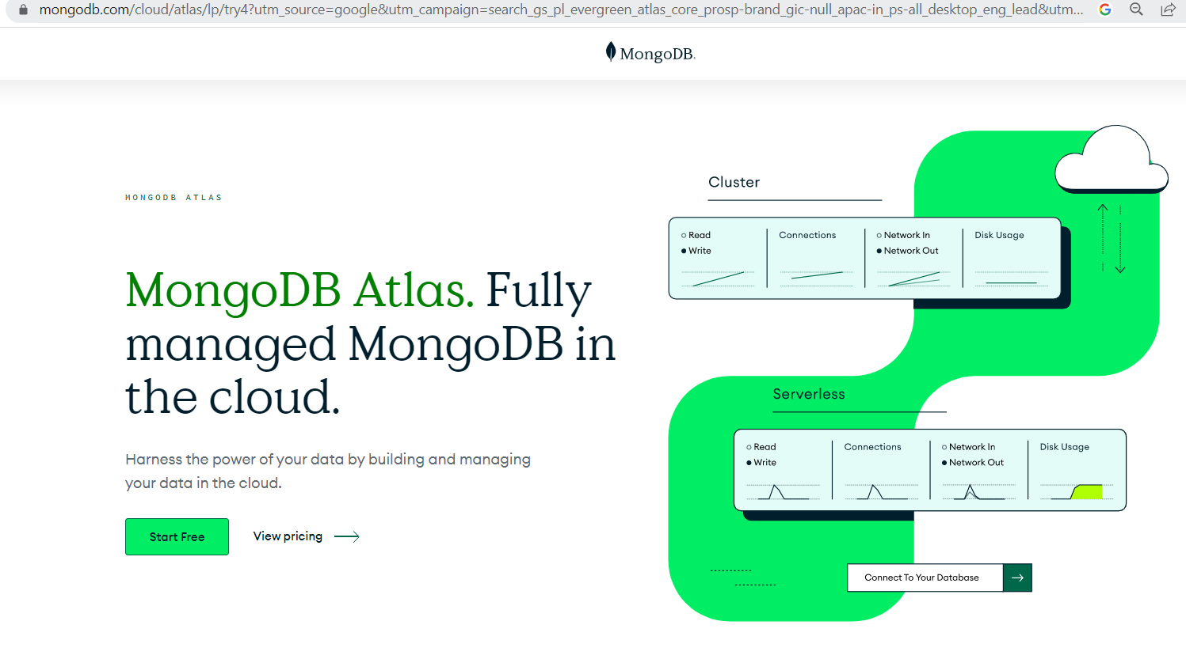
MONGODB –DOCUMENT DB
MongoDB Atlas

Slide 64
Why MongoDB?
Open Source
Distributed
Fast In-Place Updates
Replication
Full Index Support
Rich Query Language
Easy Scalability
Auto sharding

Slide 65
JSON (Java Script Object Notation)
Sample JSON Document
{
FirstName: John,
LastName: Mathews,
ContactNo: [+123 4567 8900, +123 4444 5555]
}

Slide 66
Unique Identifier
Each JSON document should have a unique identifier. It is the _id key.
0 | 1 | 2 | 3 | 4 | 5 | 6 | 7 | 8 | 9 | 10 | 11
Timestamp |  |  |  | Machine ID |  |  | Process ID |  | Counter

Slide 67
Terms Used in RDBMS and MongoDB
RDBMS | MongoDB
Database | Database
Table | Collection
Record | Document
Columns | Fields / Key Value pairs
Index | Index
Joins | Embedded documents
Primary Key | Primary key (_id is a identifier)

Slide 68


CREATE DATABASE IN MONGODB
use myDB;
Confirm the existence of your database
db;

Slide 69
CRUD (CREATE, READ, UPDATE, DELETE) OPERATIONS
To create a collection by the name “Student”.
db.createCollection(“Student”);
=> sql equivalent
CREATE TABLE STUDENT(…);

Slide 70
CREATE DATABASE IN MONGODB
use myDB;

Slide 71
Drop Collection
To drop a collection by the name “Student”.
db.Student.drop();

Slide 72
Insert Data
db.Student.insert(
{_id:1,
StudName:"MichelleJacintha",
Grade:"VII",
Hobbies:"InternetSurfing"});

Slide 73
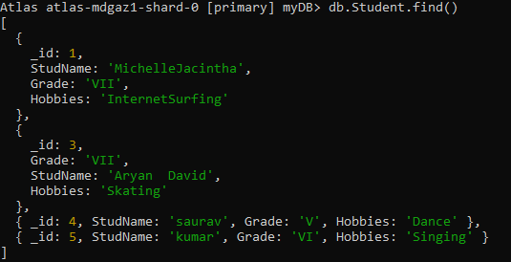
Bulk Insert
var mystudent =
[ {_id:4, StudName:"saurav", Grade:"V", Hobbies:"Dance"}, {_id:5, StudName:"kumar", Grade:"VI", Hobbies:"Singing"}]
db.Student.insert(mystudent)

Slide 74
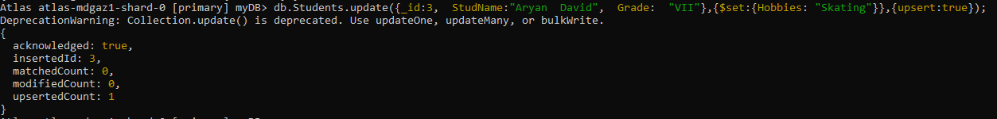
Update Method
Idb.student.update({Studname:’Aryan Dravid’},{$set:{“Studname”:”Saurav”}})

Slide 75
Update or Insert
Insert the document for “Aryan David” into the Students collection only if it does not already exist in the collection. However, if it is already present in the collection, then update the document with new values. (Update his Hobbies from “Skating” to “Chess”.) Use “Update else insert” (if there is an existing document, it will attempt to update it, if there is no existing document then it will insert it).
db.Student.update({_id:3, StudName:"Aryan David", Grade: "VII"},{$set:{Hobbies: "Skating"}},{upsert:true});

Slide 76
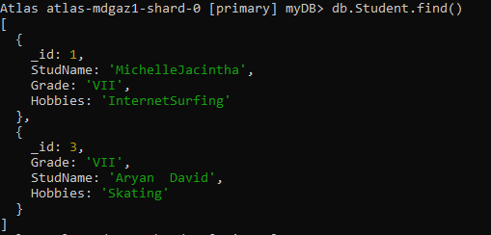
View Data
View the entire table
db.Student.find()
Same as
Select * from table;

Slide 77
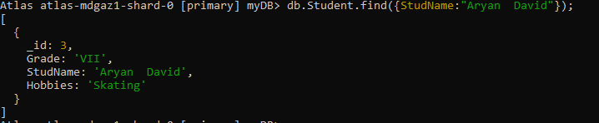
Find Method (Search Based on Criteria)(1)
To search for documents from the “Students” collection based on certain search criteria.
db.Student.find({StudName:"Aryan David"});

Slide 78

Find Method (Search Based on Criteria)(2)
To display only the StudName and Grade from all the documents of the Students collection.
The identifier _id should be suppressed and NOT displayed.
db.Students.find({},{StudName:1,Grade:1,_id:0});

Slide 79
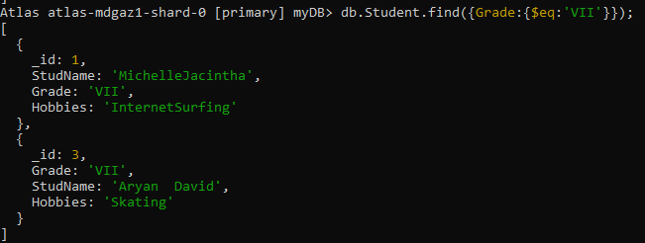
Find Method (Search Based on Criteria)(3)
To find those documents where the Grade is set to ‘VII’
db.Students.find({Grade:{$eq:'VII'}})

Slide 80
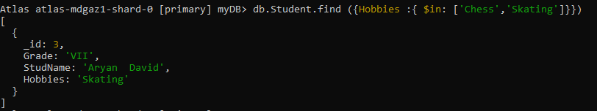
Find Method (Search Based on Criteria)(4)
To find those documents from the Students collection where the Hobbies is set to either ‘Chess’ or is set to ‘Skating’.
db.Students.find ({Hobbies :{ $in: ['Chess','Skating']}})

Slide 81
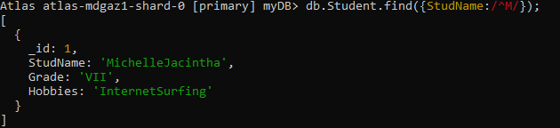
Find Method (Search Based on Criteria)(5)
To find documents from the Students collection where the StudName begins with “M”.
db.Students.find({StudName:/^M/});

Slide 82
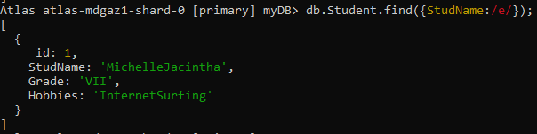
Find Method (Search Based on Criteria)(6)
To find documents from the Students collection where the StudName has an “e” in any position.
db.Students.find({StudName:/e/});

Slide 83
Count Method
To find the number of documents in the Students collection.
db.Student.count();

Slide 84
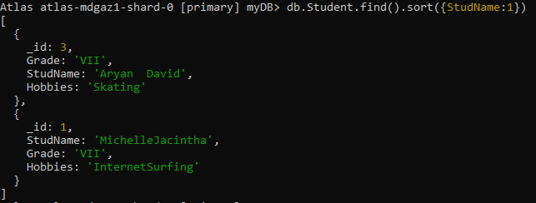
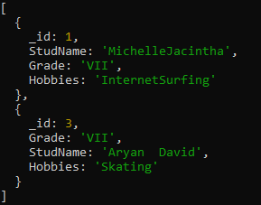
Sort Method
To sort the documents from the Students collection in the ascending order of StudName.
db.Students.find().sort({StudName:1})
To sort the documents from the Students collection in the descending order of StudName.
db.Students.find().sort({StudName:-1})

Slide 85
Remove data
db.Student.remove({"StudName":"saurav"})
db.student.find({"StudName":"saurav"});

Slide 86
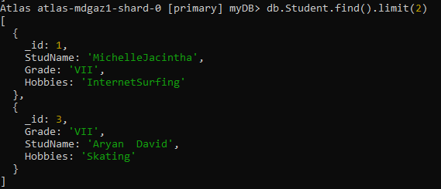
Display using Limit
db.Student.find().limit(2)

Slide 87
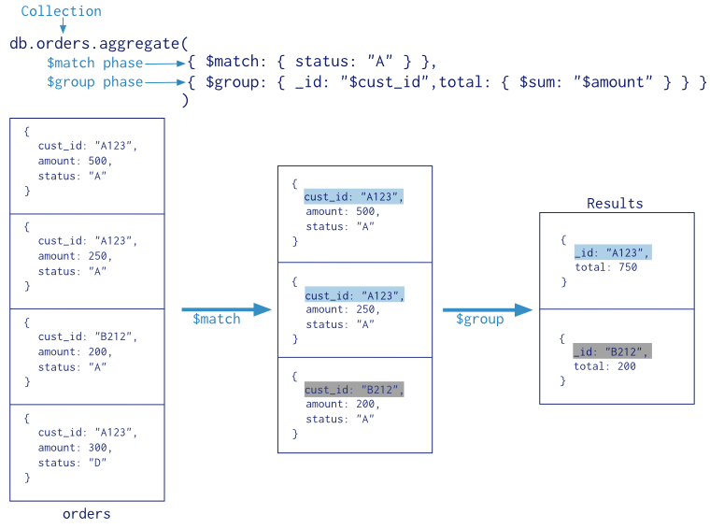
Aggregate Function in MongoDb (example)

Slide 88
Aggregation
Aggregation is a way of processing a large number of documents in a collection by means of passing them through different stages.
The stages make up what is known as a pipeline. The stages in a pipeline can filter, sort, group, reshape and modify documents that pass through the pipeline.
One of the most common use cases of Aggregation is to calculate aggregate values for groups of documents.

Slide 89
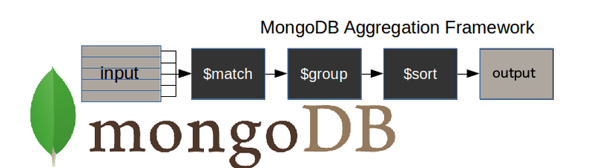
How does the MongoDB aggregation pipeline work?
$match stage – filters those documents we need to work with, those that fit our needs
$group stage – does the aggregation job
$sort stage – sorts the resulting documents the way we require (ascending or descending)

Slide 90
MongoDB aggregate pipeline syntax
db.collectionName.aggregate(pipeline, options),
where collectionName – is the name of a collection,
pipeline – is an array that contains the aggregation stages,
options – optional parameters for the aggregation

Slide 91
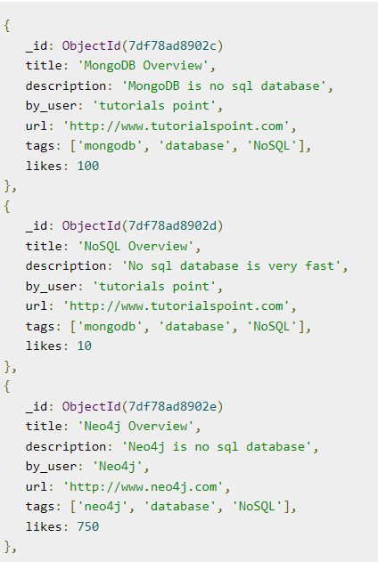
Example
Assume the following collection

Slide 92
Display a list stating how many tutorials are written by each user
> db.mycol.aggregate([{$group : {_id : "$by_user", num_tutorial : {$sum : 1}}}])
Output:
{ "_id" : "tutorials point", "num_tutorial" : 2 }
{ "_id" : "Neo4j", "num_tutorial" : 1 }

Slide 93
db.mycol.aggregate([
{$group : {_id : "$by_user", num_tutorial : {$sum : "$likes"}}}])

Slide 94
db.mycol.aggregate([{$group : {_id : "$by_user", num_tutorial : {$avg : "$likes"}}}])

Slide 95
db.mycol.aggregate([{$group : {_id : "$by_user", num_tutorial : {$min : "$likes"}}}])

Slide 96
db.mycol.aggregate([{$group : {_id : "$by_user", num_tutorial : {$max : "$likes"}}}])

Slide 97
Aggregate Function
First filter on “AccType:S” and then group it on “CustID” and then compute the sum of “AccBal” and then filter those documents wherein the “TotAccBal” is greater than 1200, use the below syntax:
db.Customers.aggregate( { $match : {AccType : "S" } },
{ $group : { _id : "$CustID",TotAccBal : { $sum : "$AccBal" } } },
{ $match : {TotAccBal : { $gt : 1200 } }});

Slide 98

Aggregate Function
Determine Minimum and Maximum account balance for each customer_id.
db.Customers.aggregate (
{$group : { _id : "$cust_id",
minAccBal :{$min:"$Balance"}, maxAccBal :{$max:"$Balance"} }});

Slide 99
Export data to a CSV file
This command used at the command prompt exports MongoDB JSON documents from “Customers” collection in the “test” database into a CSV file “Output.txt” in the D: drive.
mongoexport mongodb+srv://antararc:<password>@cluster0.mfnfeys.mongodb.net/myDB --collection=Student --out C:\Users\BMSCECSE\Downloads\output.json

Slide 100
Import data from a CSV file
Given a CSV file “sample.txt” in the D: drive, import the file into the MongoDB
collection, “SampleJSON”.
The collection is in the database “test”.
Mongoimport --db test --collection SampleJSON --type csv --headerline --file d:\sample.txt
mongoimport mongodb+srv://antararc:<password>@cluster0.mfnfeys.mongodb.net/myDB --collection=Student --type json --file C:\Users\BMSCECSE\Downloads\output.json

